Slide 1
ARTIFICIAL INTELLIGENCE(AI)
BY ANKUSH KUMAR(2221137)

Slide 2
CONTENTS
 | INTRODUCTION
 | HISTORY
 | APPLICATION
 | FUTURURE OF A.I
 | A.I IN DAILY LIFE
 | CONCLUSION

Slide 3
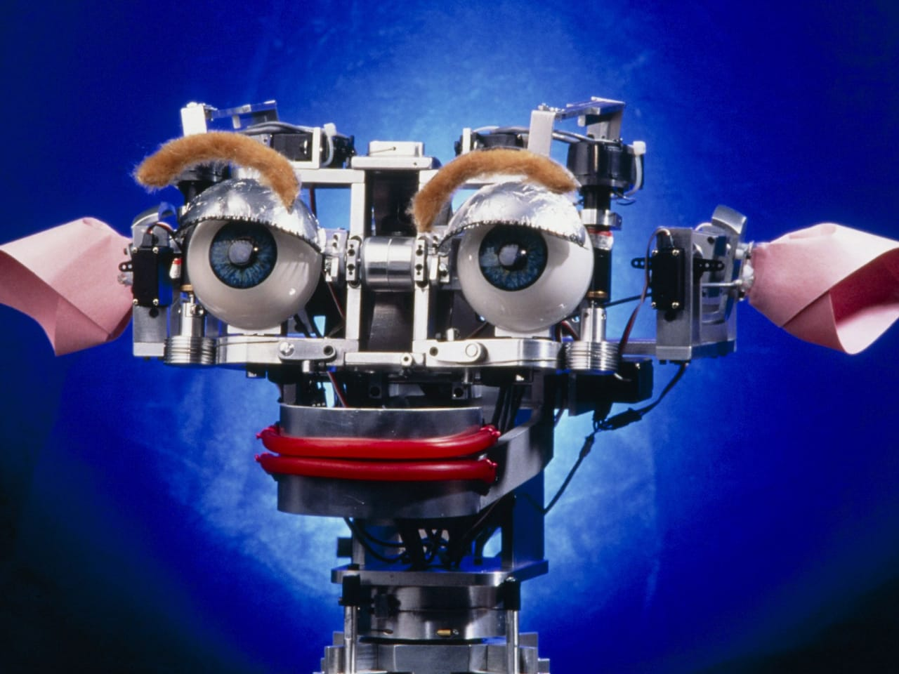
INRODUCTION
What's artificial intelligence or A.I?
Artificial intelligence (AI) is intelligence exhibited by machines. In computer science, an ideal "intelligent" machine is a flexible rational agent that perceives its environment and takes actions that maximize its chance of success at some goal.

Slide 4
HISTORY
1943: McCullough and Pitts' invented "artificial neurons".
1950: Inventions of Alan Turing's "Computing machinery and Intelligence".
1951: Al was using in Games.1956 Dartmouth conference; And the birth of Al.
1965: Robinson's complete algorithm for logical reasoning.
1969-79: Early development of knowledge based systems took place.
1980-88: Expert system industry booms.

Slide 5
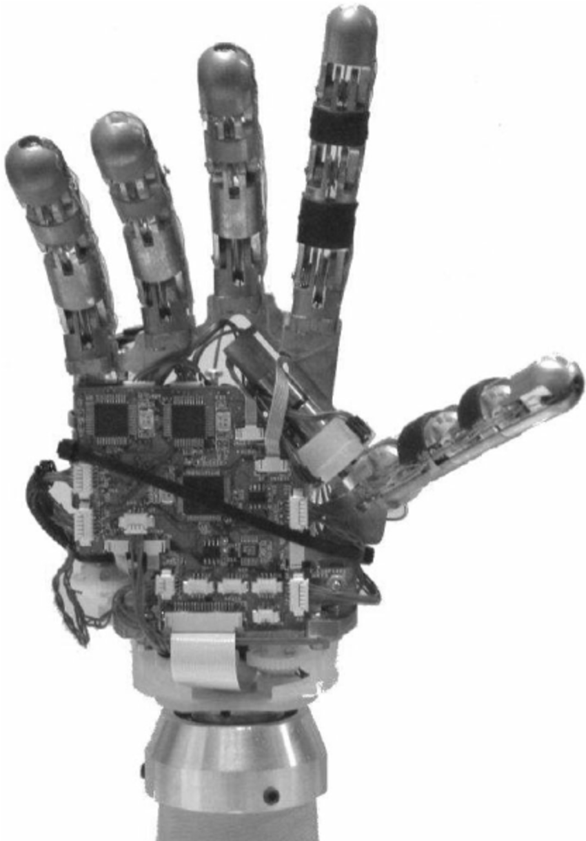
1988-93: Expert system industry busts "Al winter".
1993-Present: Al is now using rapidly in different technologies; And is achieving it's goal.

Slide 6
Applications
• Expert systems.
• Natural Language Processing (NLP).
• Speech recognition.
• Computer vision.
• Robotics.
• Automatic Programming.

Slide 7
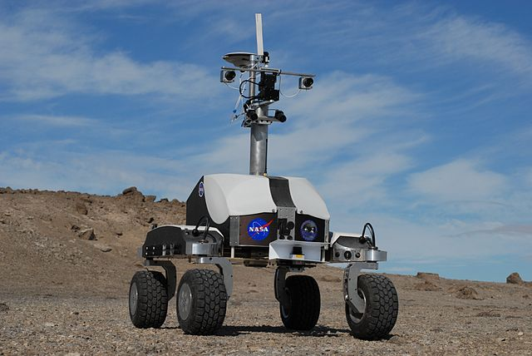
➤ Expert System
An Expert System is a computer program designed to act as an expert in a particular domain (area of expertise). Domain of E.S. Knowledge base Facts Heuristics Phases in Expert System. Expert systems currently are designed to assist experts, not to replace them, They have been used in medical diagnosis, chemical analysis, geological explorations etc.

Slide 8
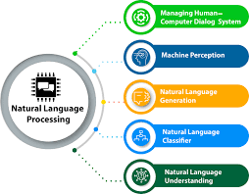
➤ Natural Language Processing
The goal of NLP is to enable people and computers to LP communicate in a natural(humanly) language(such as, English) rather than in a computer language.

Slide 9
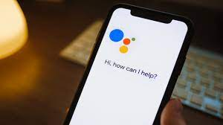
➤ Speech Recognition
The primary interactive method of communication used by humans is not reading and writing, it is speech. The goal of speech recognition research is to allow computers to understand human speech. So that they can hear our voices and recognize the words we are speaking. It simplifies the process of interactive communication between people and computers, thus it advances the goal of NLP.

Slide 10
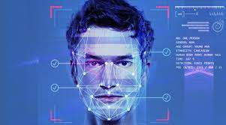
➤ Computer Vision
People generally use vision as their primary means of sensing their environment, we generally see more than we hear, feel or smell or taste. The goal of computer vision research is to give computers this same powerful facility for understanding their surrounding. Here A.l helps computer to understand what they see through attached cameras.

Slide 11
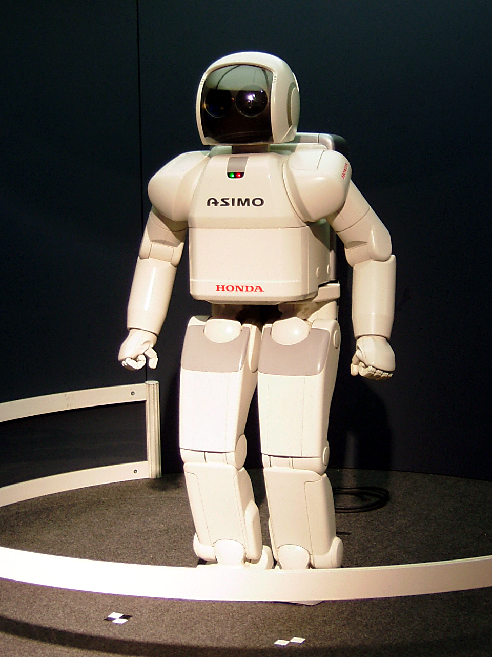
➤ Robotics
A Robot is a electro-mechanical device that can by programmed to perform manual tasks or a reprogrammable multi functional manipulator designed to move materials, parts, tools, or specialized devices through variable programmed motions for performance of variety of tasks. An 'intelligent' robot includes some kind of sensory apparatus that allows it to respond to change in it's environment.

Slide 12
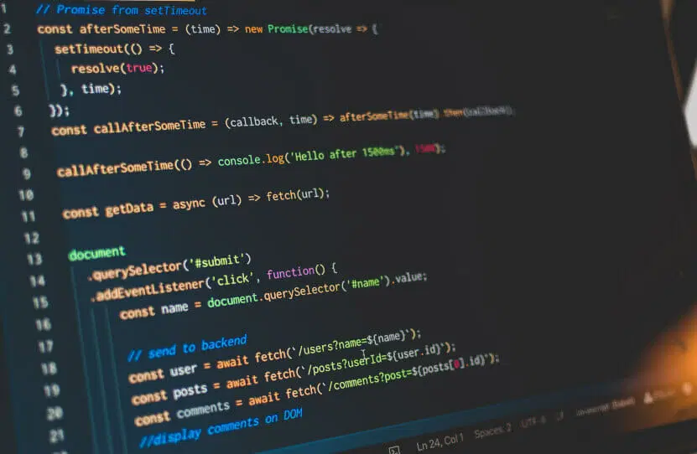
➤ Automatic Programming
Automatic programming is the generation of programs by computer, usually based on specifications that are higher-level and easier for humans to specify than ordinary programming languages. It's one of the most important part of A.I.

Slide 13
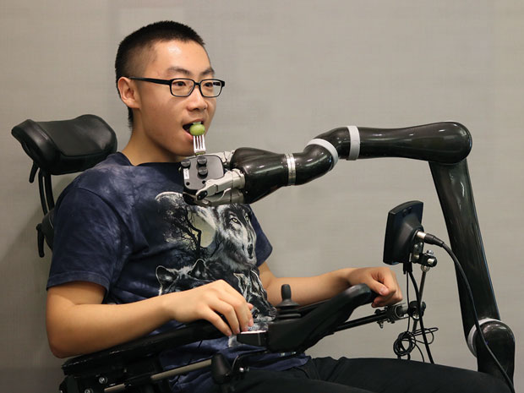
➤ Future of A.i
The future is really UNKNOWN.
Researchers seem to disagree on a lot of the same issues.
With the rate at which technology is improving it is logical to believe Ai will continue to get more and more sophisticated.

Slide 14
But we can imagine two different kind of future of A.i.
They are:
1) Positive
2) Negative

Slide 15
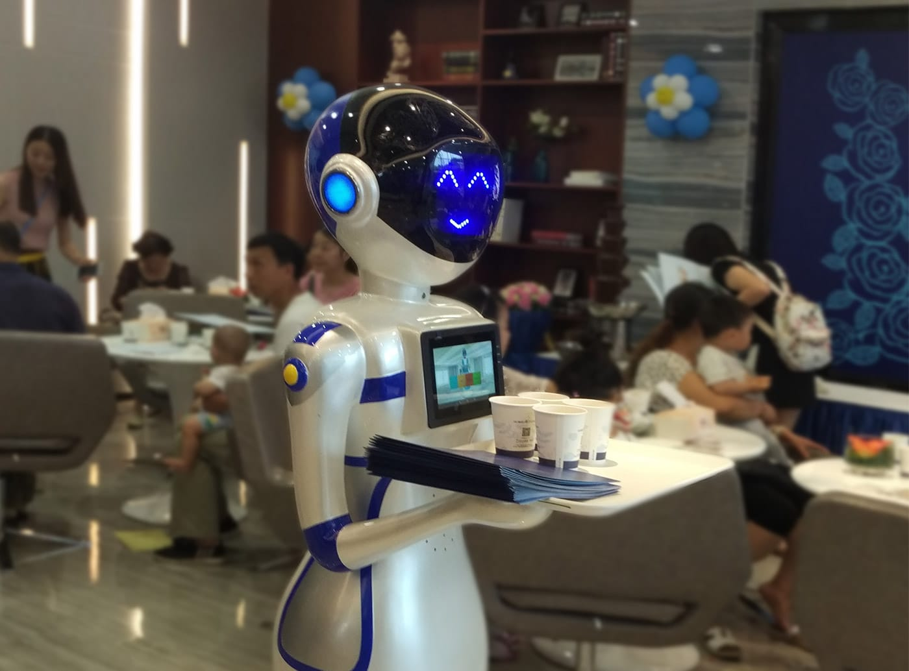
Positive imagination of Future
Maybe, the day is not far when we will just sit back in our cozy little beds and just command our personal Robot's to entirely do our ruts. He will be a perfect companion for us. Just enjoy the Technology.

Slide 16
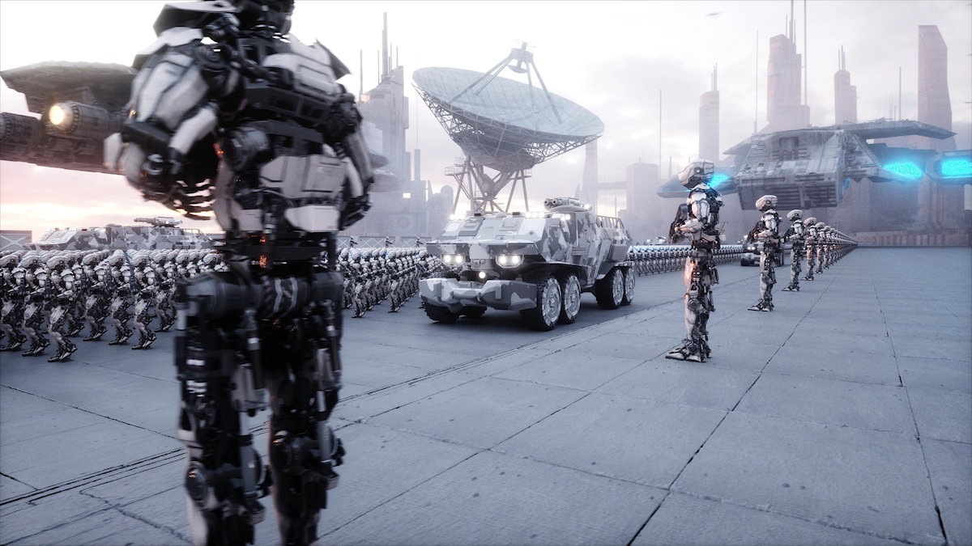
➤ Negative imagination of Future
It may end in other way too. Some day there will be a knock at our door. As we open it, we'll see a large number of Robots marching into our house destroying everything we own and looting you. This is because ever since there is an advantage in the Technology, it attracts anti- social elements. This is true for Robots too. Because now they will have full power to think as human, even as of anti-social elements. So we should think trice before giving them power of Cognition.

Slide 17
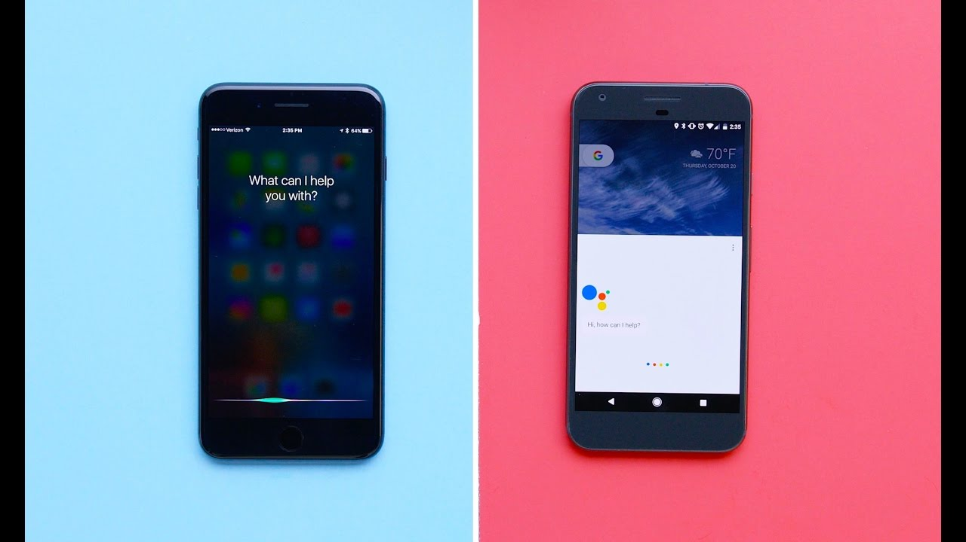
A.I in daily life
➤ Virtual Personal Assistant
Siri, Google Now, and Cortana are all intelligent digital personal assistants on various platforms(iOS, Android, Windows) which are based on A.I.

Slide 18
➤ Video Games
One of the instances of Al that most people are probably familiar with, video game Al has been used for a very long time-since the very first video games, in fact.

Slide 19
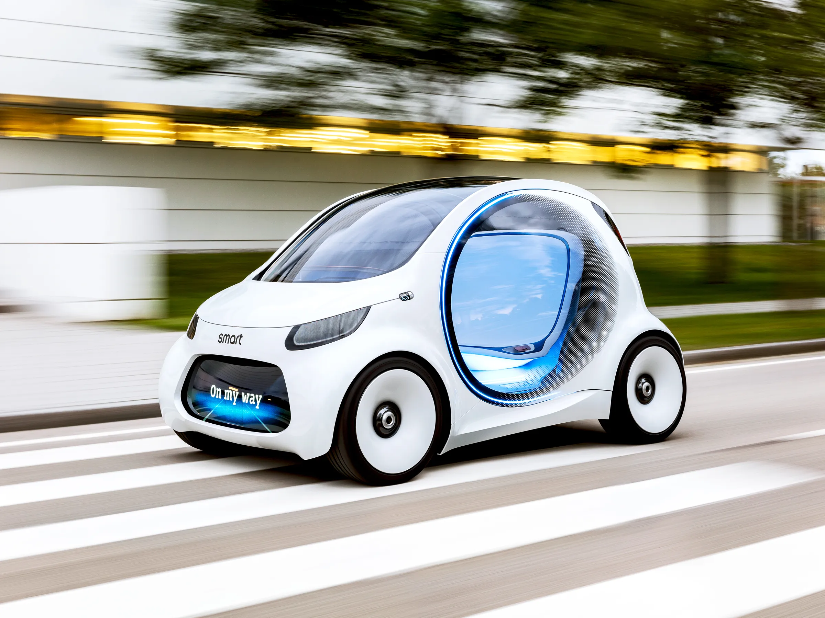
► Smart Cars
Although we haven't seen smart cars on street yet. But as the Artificial intelligence is developing, that day is not so far when we won't need a driver.

Slide 20
Conclusion
In it's short existence, Al has increased understanding of the nature of intelligence and provided an impressive array of application in a wide range of areas. It has sharpened understanding of human reasoning, and of the nature of intelligence in general. At the same time, it has revealed the complexity of modeling human reasoning providing new areas and rich challenges for the future.

Slide 21
THANK you!!!

